Slide 1
Types of Connectors
When you are installing a network, you need to have plenty of cable connectors for connecting patch panels to network switches and servers or computers. The types of wiring connectors used depends on the network cable types.
The types of wiring connectors used depends on the network cable types. There are different connectors for Ethernet/twisted-pair, coaxial, USB and fiber optic cables.

Slide 2
Ethernet Cable Connectors
RJ45 connectors are used for CAT6 cables and CAT5e cables. These connectors for twisted-pair Ethernet cables are similar in appearance to a standard telephone cord connector. They are wider, however, because they have eight conductors compared to only four conductors on a telephone jack.
To install these types of wiring connectors, a stripping tool is used to expose the twisted pairs of wires from the cable, which are then positioned into the appropriate slots on the terminal plug. The connector is then crimped to the cable using a crimping tool.

Slide 3
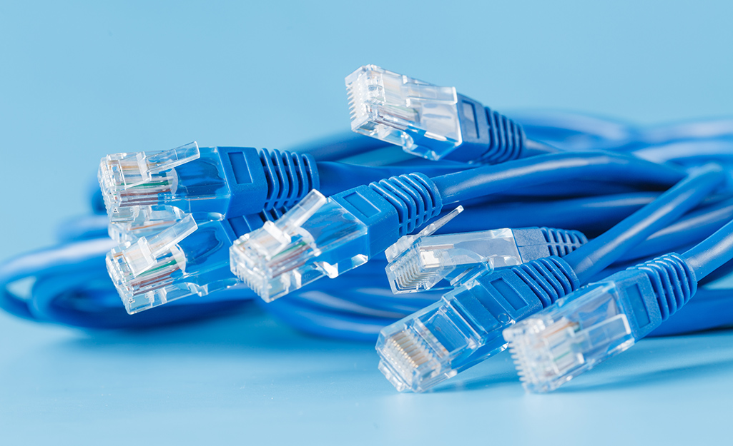

Slide 4
Coaxial Cable Connectors
BNC connectors are a type of F-series connectors commonly found in households. This type of connector for RG59 or RG6 coaxial cable is used for cable television equipment, broadcast TV antennas and CCTV security camera installations. They are easy to connect and disconnect from equipment and provide inexpensive, stable connections to these communications devices and other cables.
To install a BNC connector, use a stripping tool to remove protective shields from the cable. The connector is pushed onto the end and then squeezed around the conductive material using a special compression crimper.
Twist-on F-connectors are also available for making quick and easy repairs to TV equipment without the need for special tools.

Slide 5
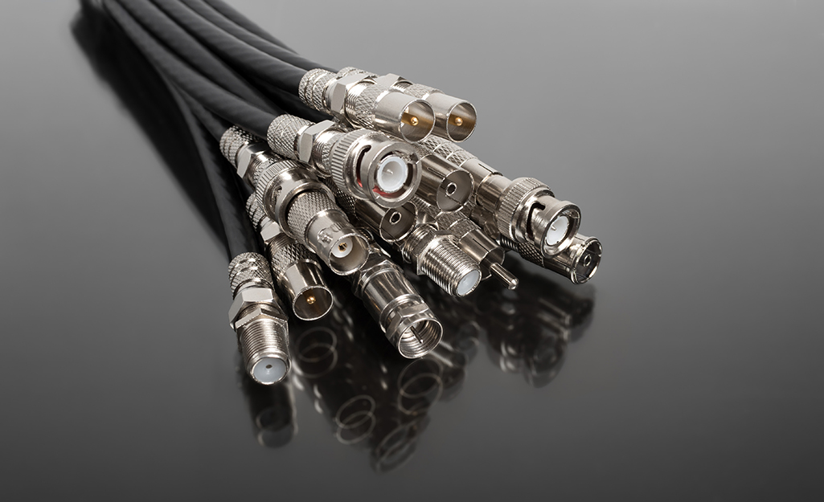

Slide 6
USB Connectors
USB connectors are the most familiar to the majority of people. USB (Universal Serial Bus) connectors typically join external devices to a personal computer or are used for mobile phone charging. There are adapters that will allow an Ethernet cable to connect directly to a USB port, though this type of setup would be a temporary solution for networking.

Slide 7
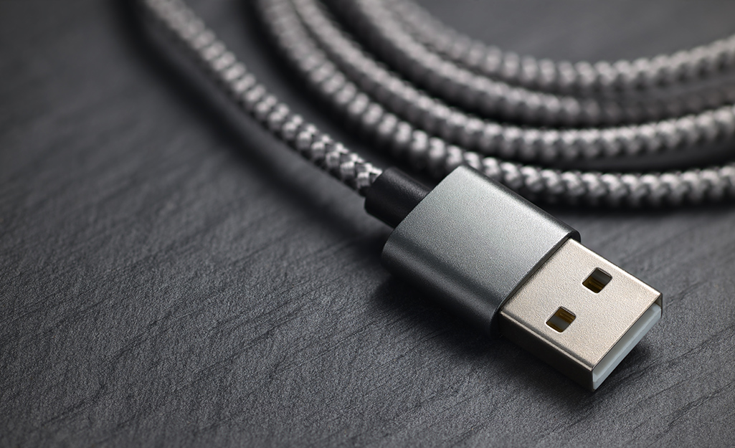

Slide 8
Fiber Optic Cable Connectors
Fiber optic connectors require different types of connectors from those used with coax or twisted-pair cables, such as CAT5e. These types of connectors in networking must align glass fibers with precision to allow for communication. If you choose to use optical cable over twisted pair Ethernet, you may need to install a special adapter in your computer to utilize various fiber optic cable connector types.
The type of wiring connector used depends on the style of jack in the peripheral device.
SC connectors: A push-pull latching mechanism in SC connectors provides quick insertion and removal while also ensuring a positive connection.
ST connectors: ST connectors were among the first connectors in networking fiber optic cable. These use a plug and socket, which is locked in place with a twist-style bayonet lock.
LC connectors: LC-type connectors have a squarish duplex configuration. Installation of this small form factor (SFF) connector is quick for rapid repair of replacement needs.

Slide 9
